Slide 1

Microsoft 365 platform community call
aka.ms/m365pnp
Your host in this call: Brian T. Jackett
April 19, 2022

Slide 2
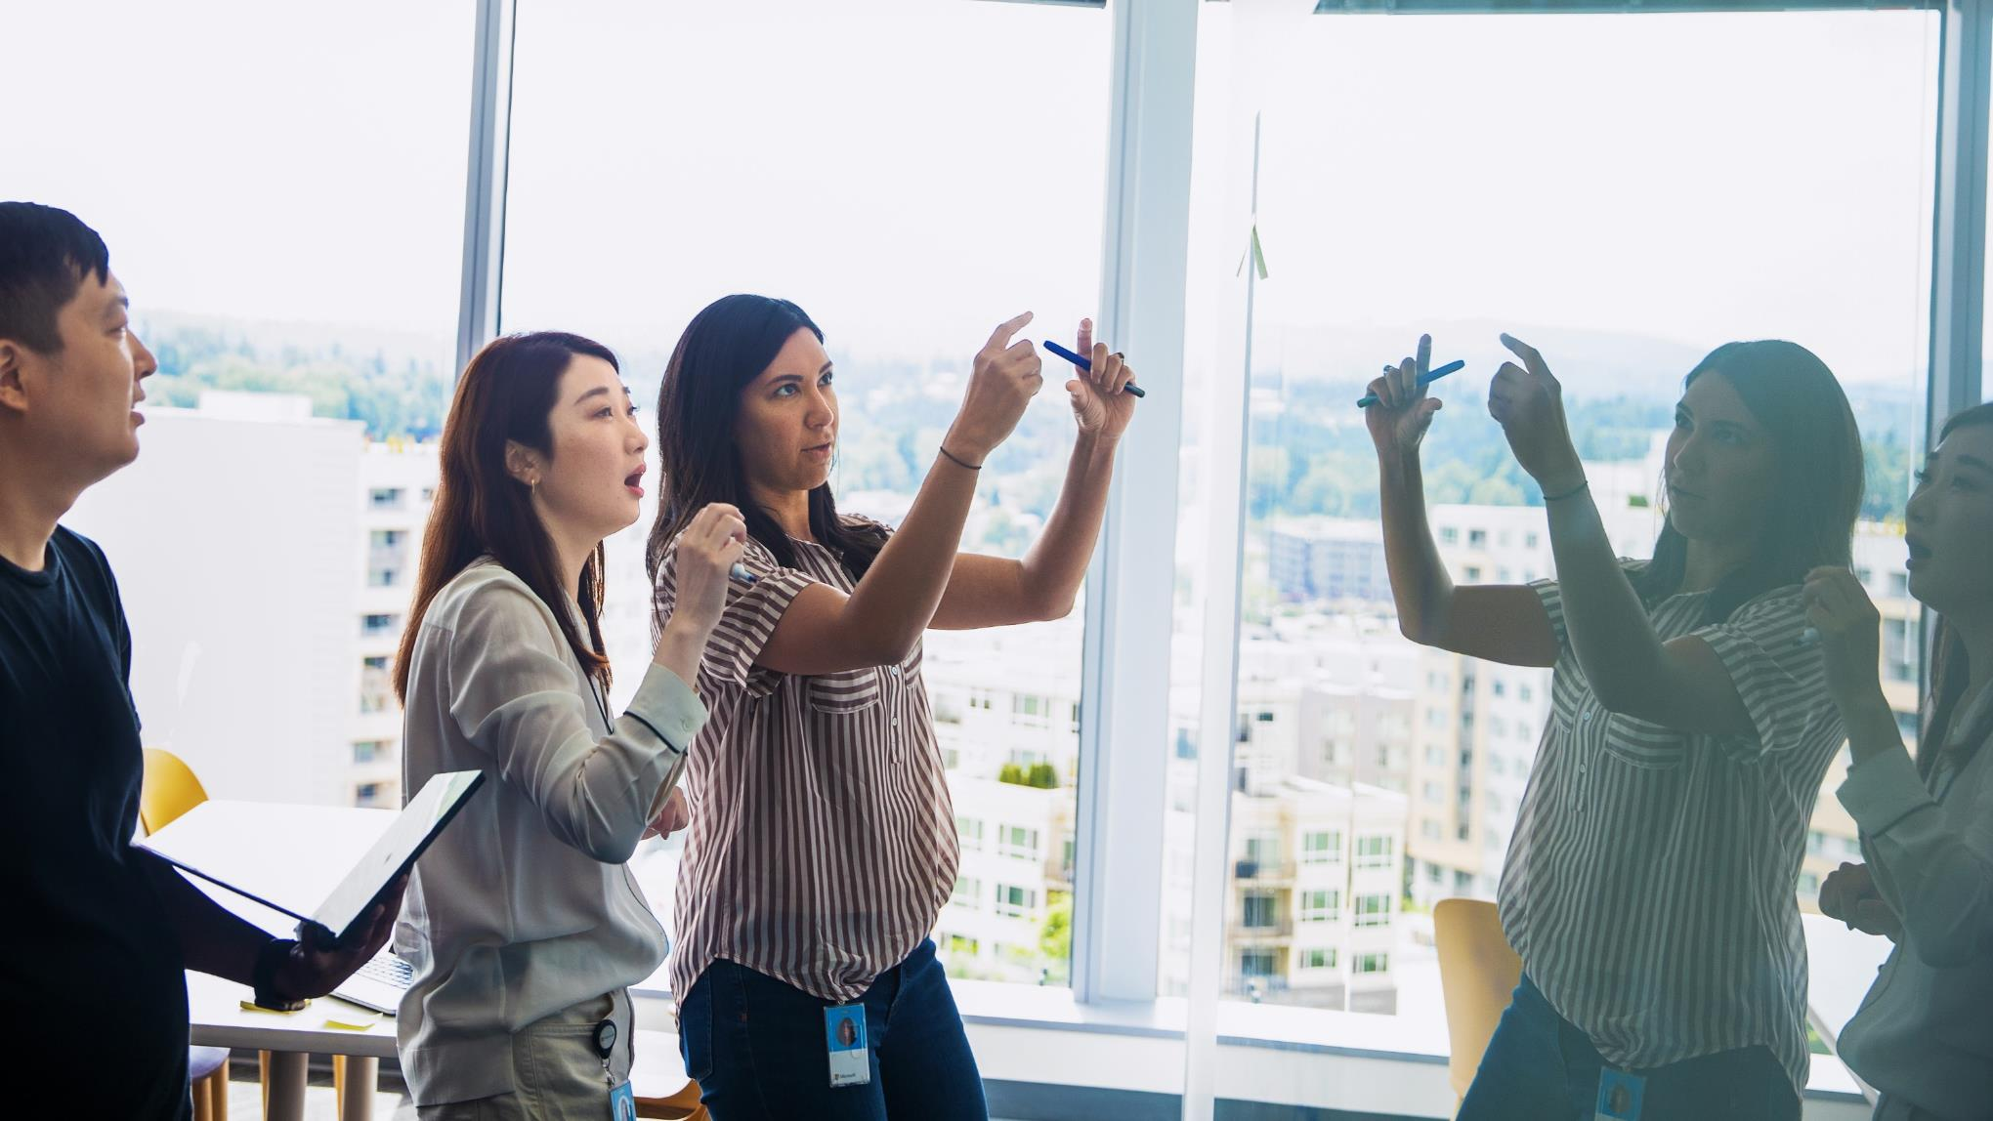



Agenda
Latest updates and news on the Microsoft 365 platform
Monthly community contributors
Group picture time with Together Mode!
Demos
Nik Charlebois - Latest on Microsoft Graph Data Connect datasets
Saurabh Bhatia – Extending Teams apps to Outlook and Office.com
Brian T. Jackett – Graph Connectors updates and Postman samples

Slide 3
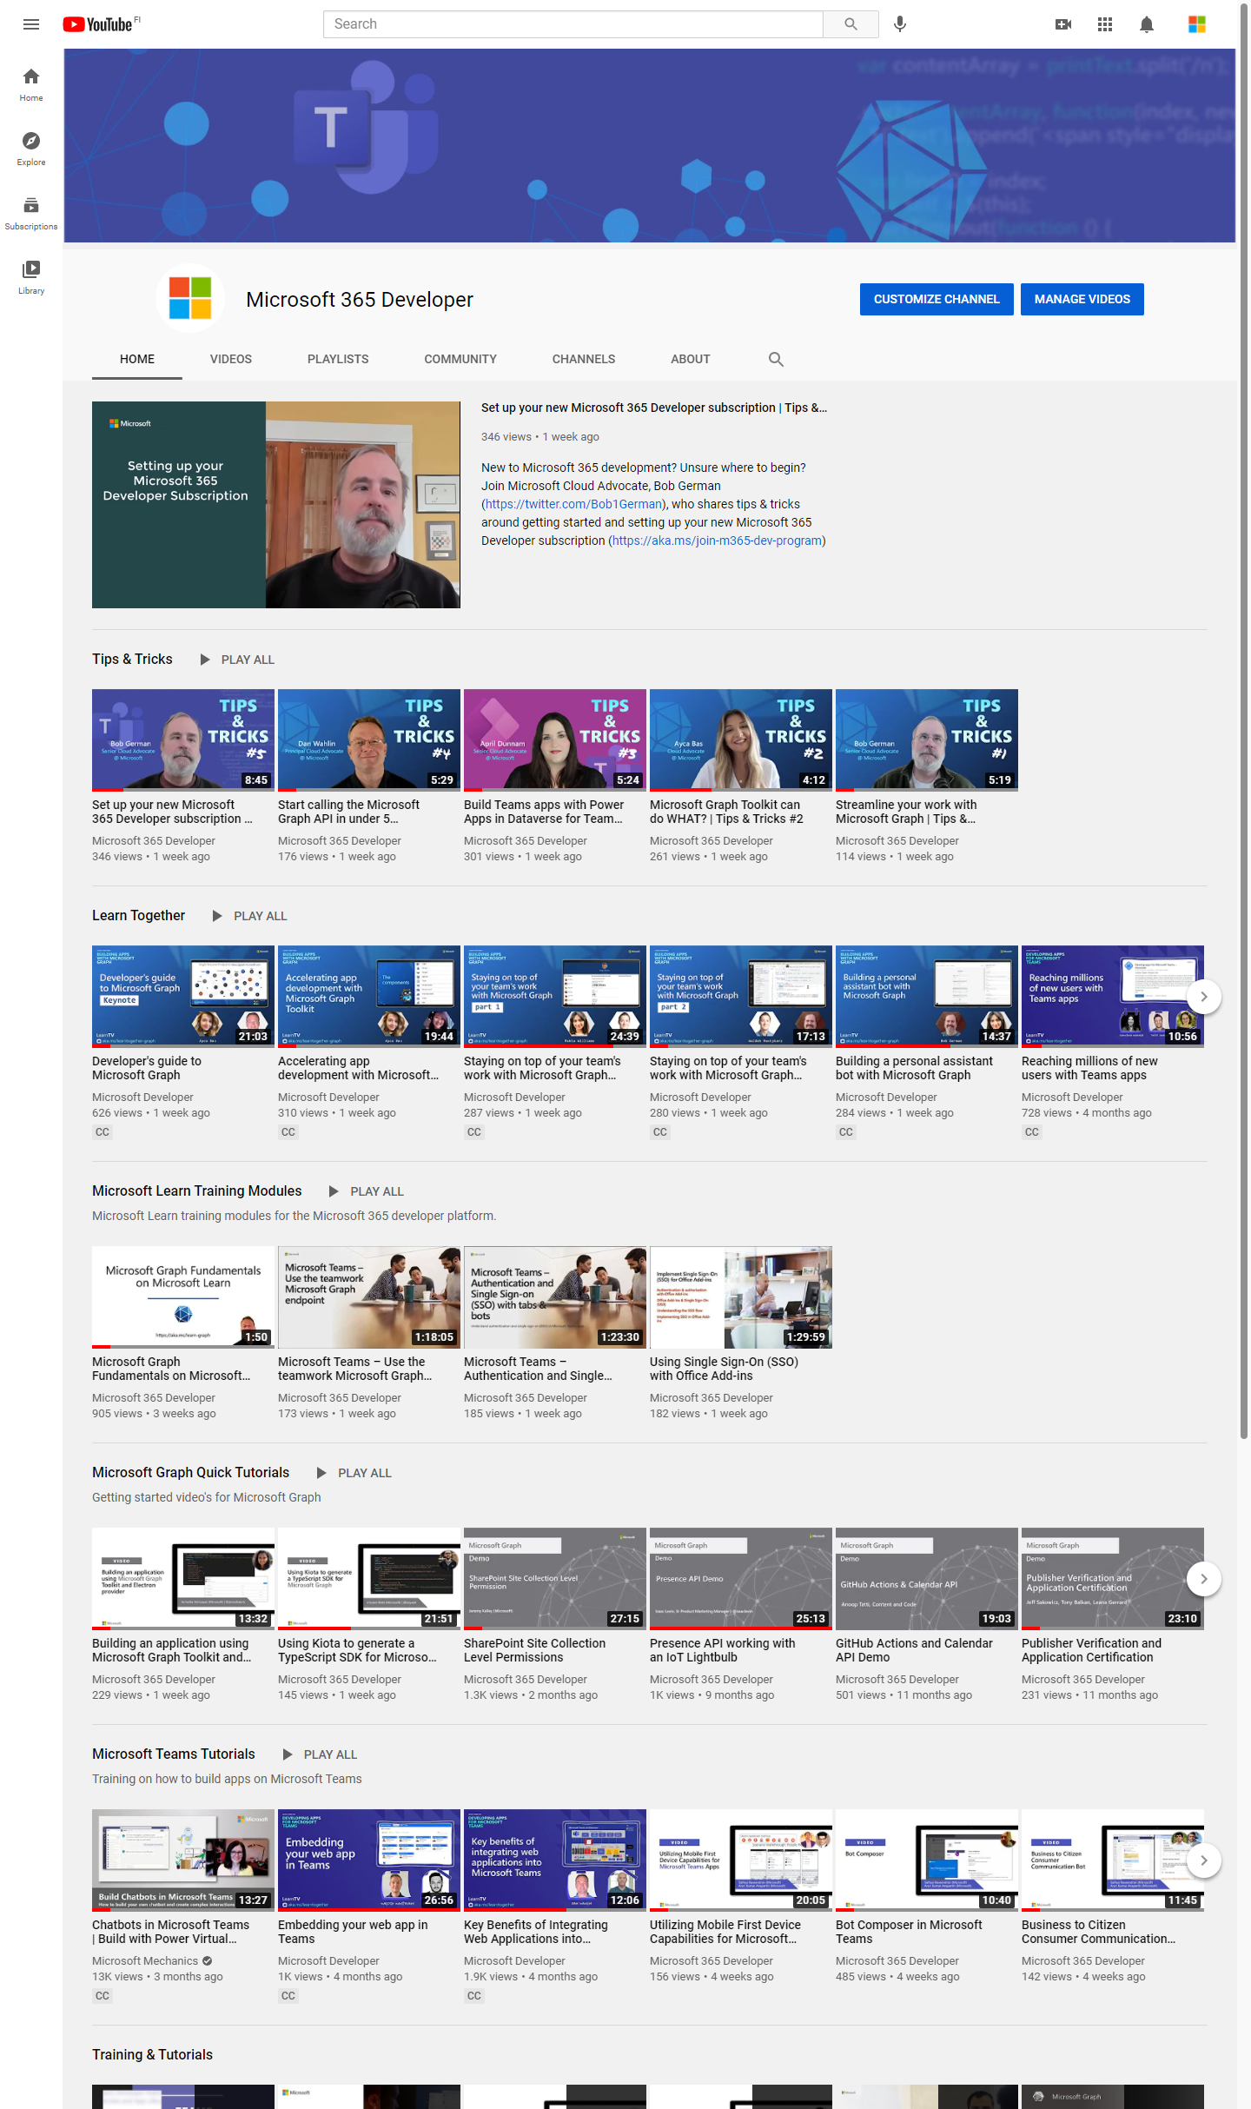
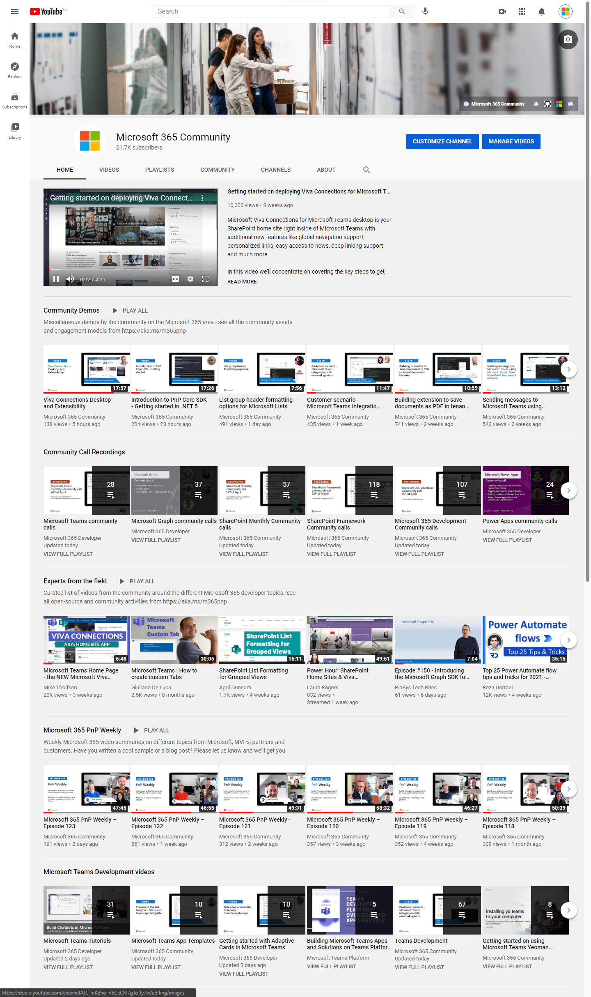
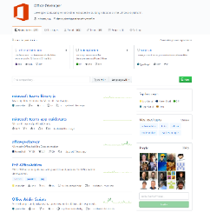
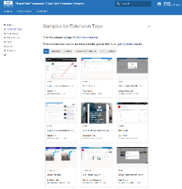
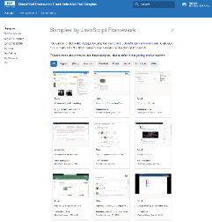
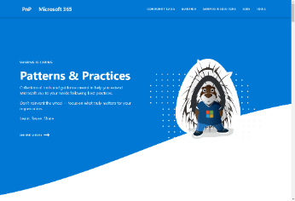
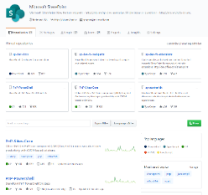
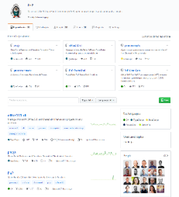
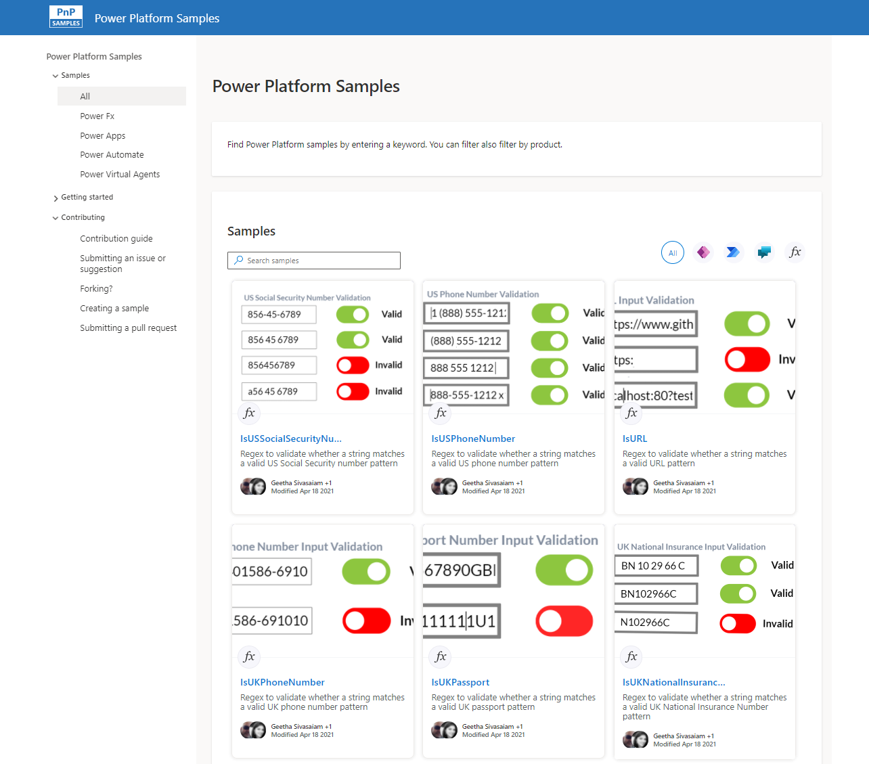
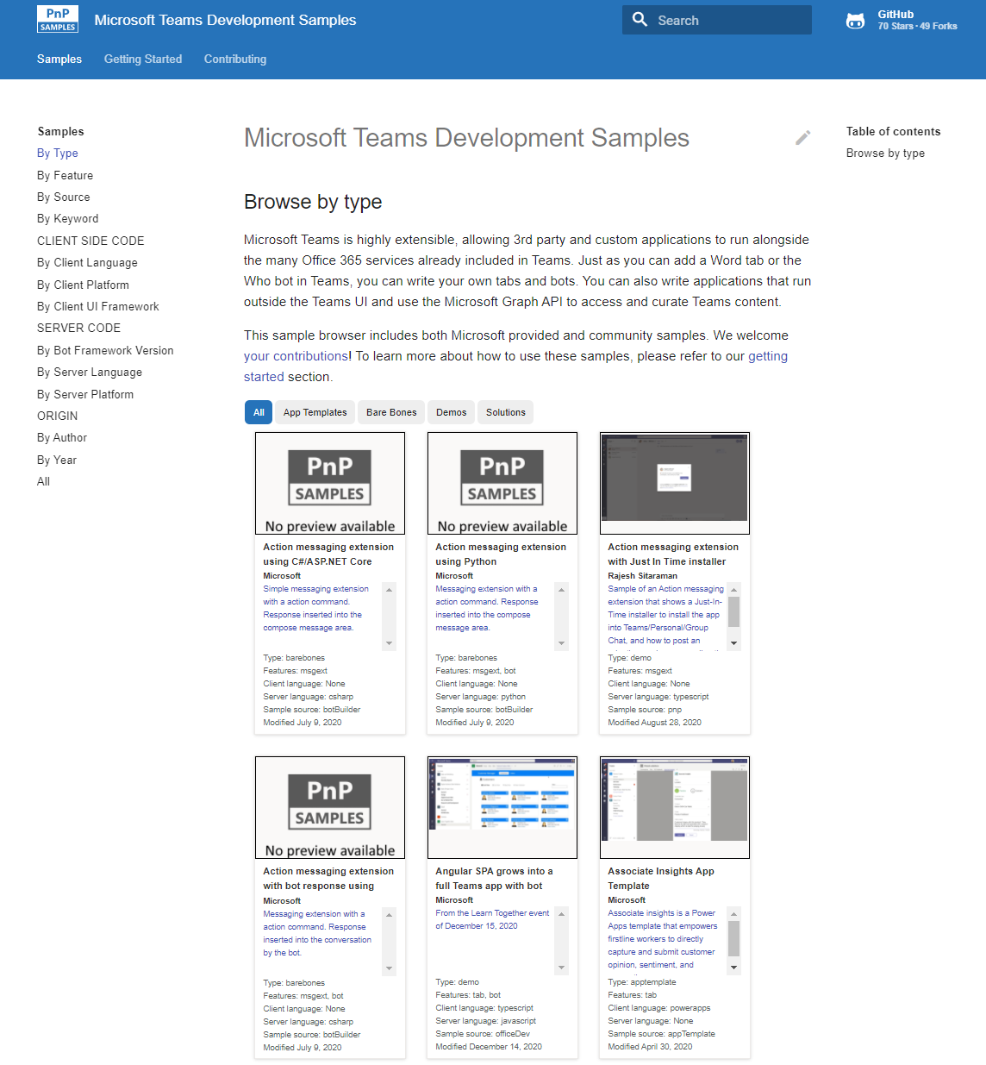
Microsoft 365 developer videos
Microsoft 365 community videos
Open-source
Sample galleries
Open-source initiatives and samples
aka.ms/m365devyoutube
aka.ms/m365/videos
github.com/pnp
github.com/officedev
github.com/sharepoint
github.com/microsoftgraph
aka.ms/m365/samples
aka.ms/teams-samples
aka.ms/spfx-webparts
aka.ms/powerplatform-samples
aka.ms/spfx-extensions
aka.ms/list-formatting
aka.ms/m365pnp
@Microsoft365Dev | @m365pnp

Slide 4

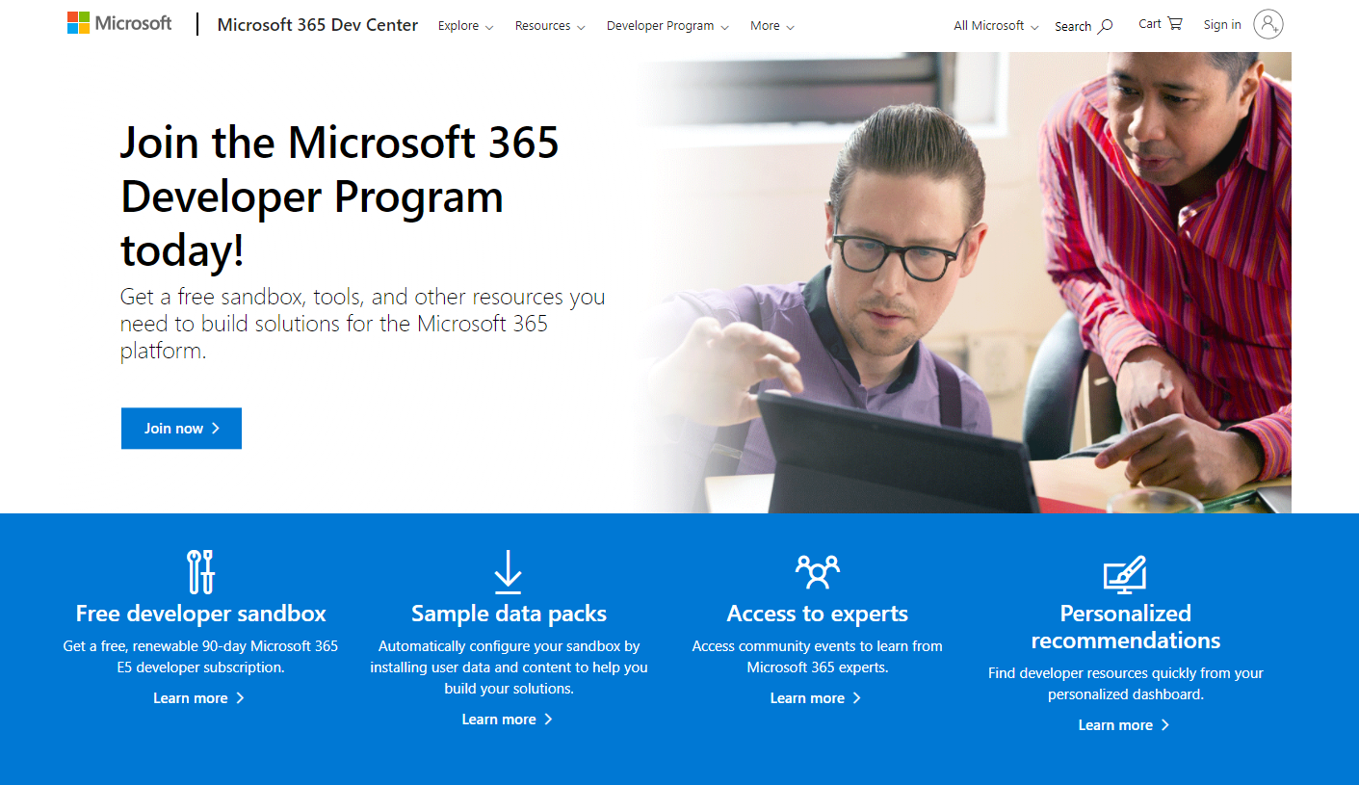

Now with instant availability!
GUIDANCE
Register to Microsoft 365 Developer Program for free E5 developer tenant and other assets
aka.ms/m365/devprogram

Slide 5
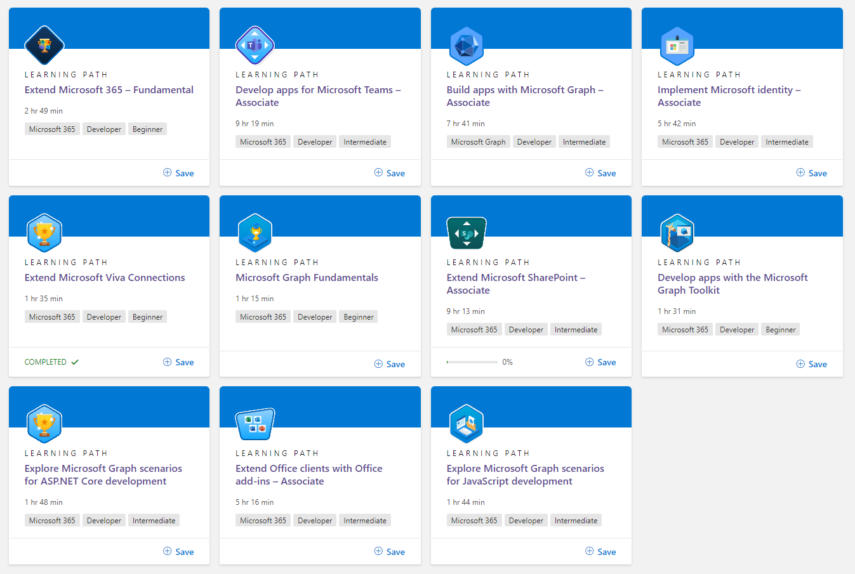
FREE!
LEARN
Get started on learning Microsoft 365 platform capabilities with these free training modules!
http://aka.ms/m365/dev/learn
Notes:
74 training modules – latest on building Microsoft Teams meeting apps

Slide 6
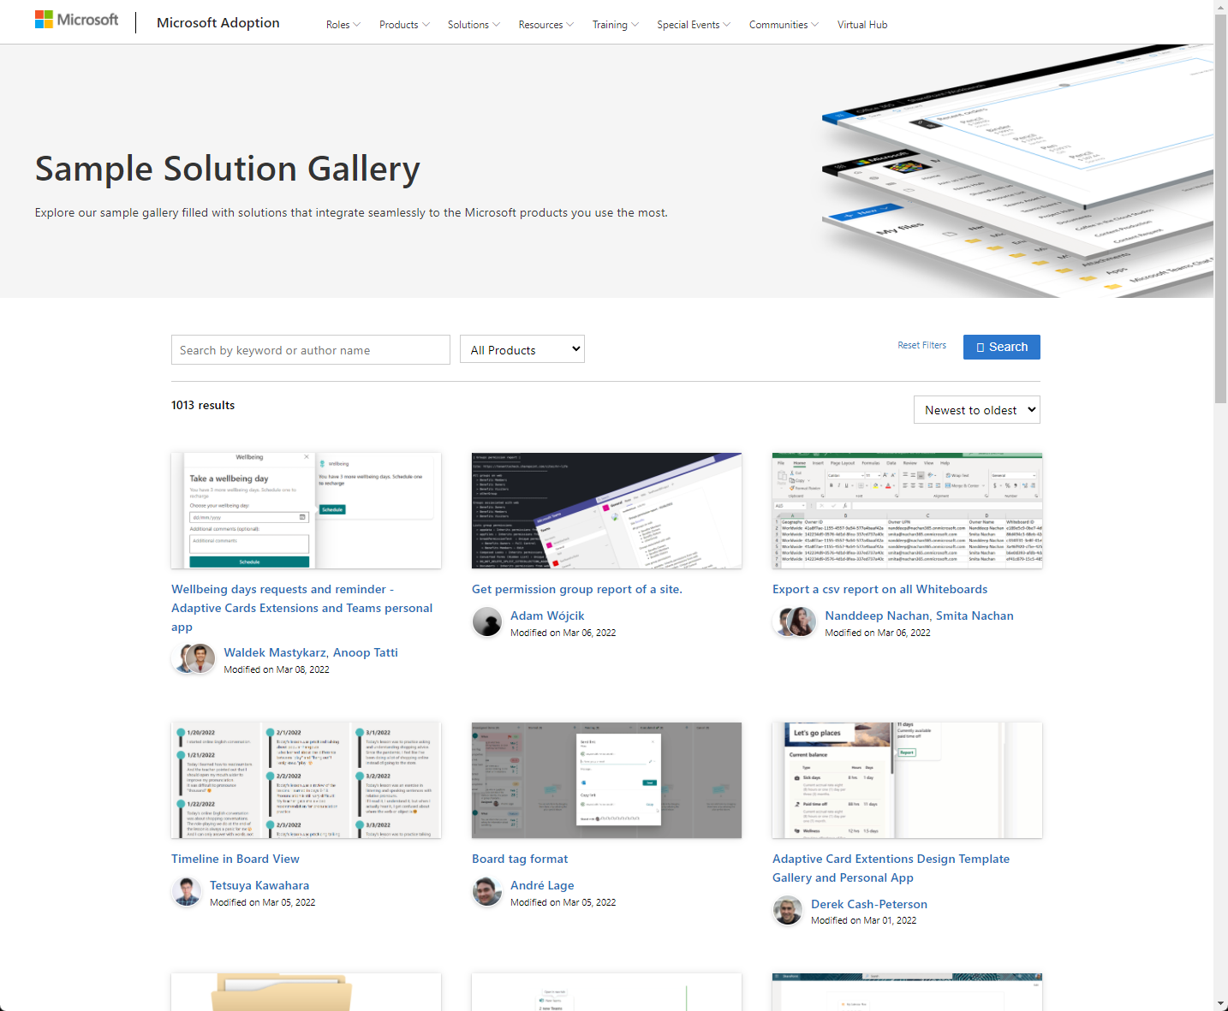
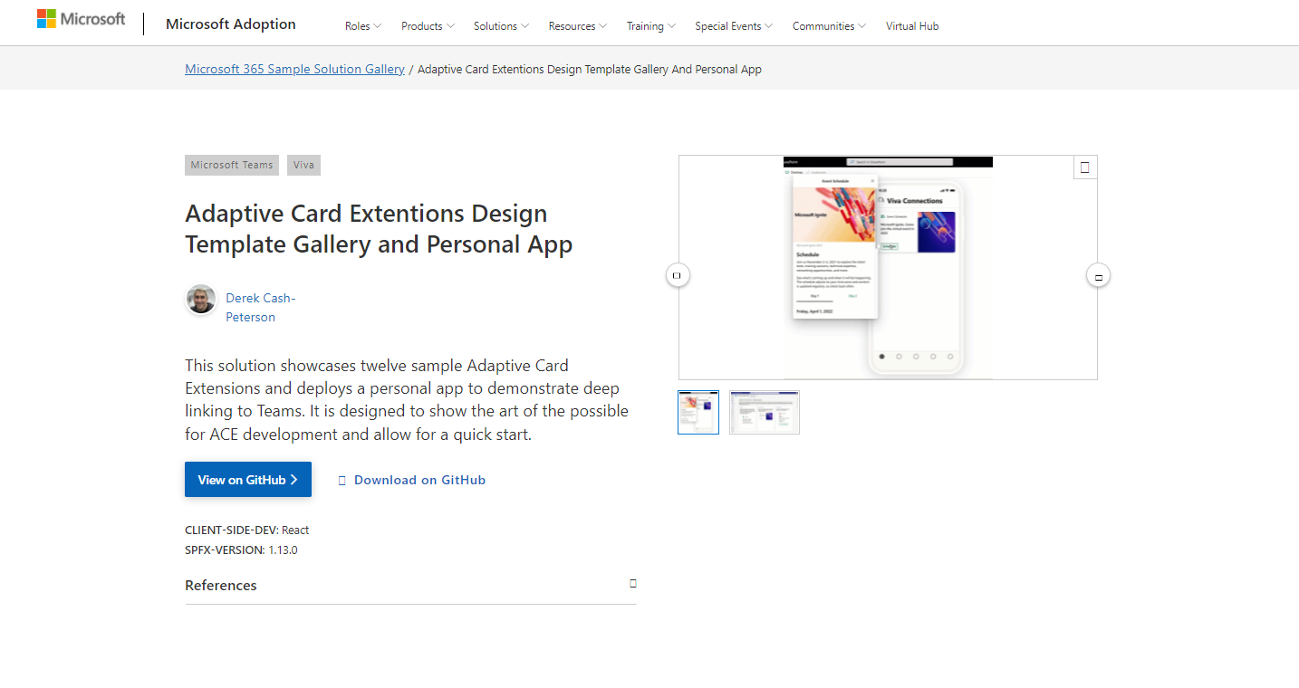
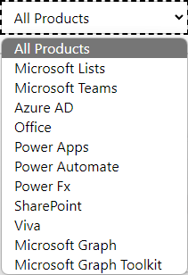
SAMPLES
New Microsoft 365 sample gallery with more than 500 samples from Microsoft and community
1060
aka.ms/m365/samples

Slide 7

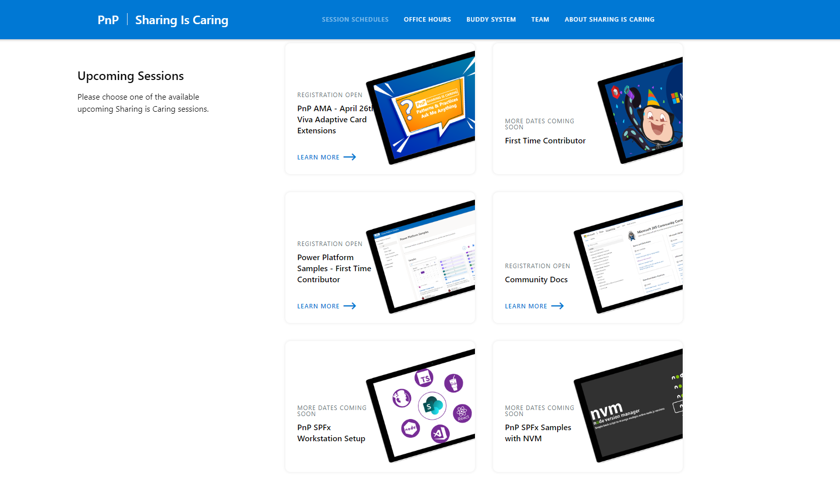
GUIDANCE
Learn how to get started in the open-source PnP community!
Upcoming Sessions:
General First Time Contributor
Power Platform Samples – First Time Contributor
Community Docs
SPFx Developer Workstation Setup
Using PnP SPFx samples w/ NVM
More than code with VS Code
First-time presenter
M365 Maturity Model Practitioners
Ask me anything (Viva Connections - April 26th)
NEXT WEEK!!
https://aka.ms/sharing-is-caring
Notes:
25 Total attendees, 16 attendees who attended both First-Time Contributors and Community Docs sessions.

Slide 8

Microsoft 365 Developer Podcast
Weekly podcast concentrating fully to Microsoft 365 dev topics – hosted by Jeremy Thake (Microsoft) and Paul Schaeflein (Addin365)
m365devpodcast.com
Notes:
Latest – 14th of March - Microsoft Teams development ”plus” with Tom Morgan

Slide 9
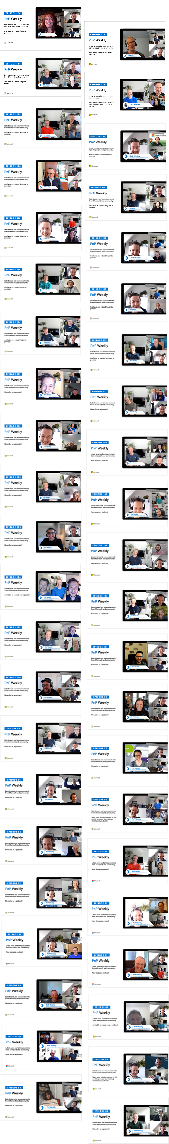
UPDATES
Microsoft 365
PnP Weekly
Latest news and announcements
from Microsoft and community.
Video – aka.ms/pnpweekly
Podcast – pnpweekly.podbean.com
#PnPWeekly
Notes:
Tuesday 5th of April – Visitor as Arjun Menon (Tata Consultancy Services)

Slide 10

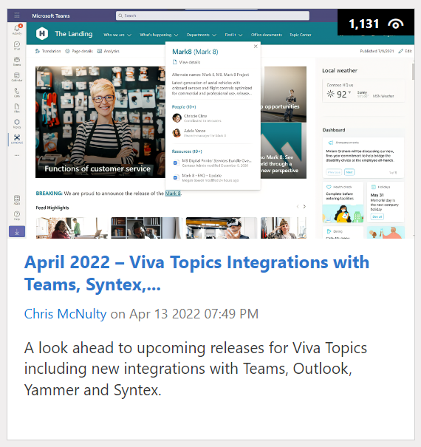
https://aka.ms/m365dev/blog
https://aka.ms/teams/blog
https://aka.ms/microsoftviva/blog
Notes:
New pull as needed sync model for content types along with APIs
Recap news and announcements from Enterprise Connect including Teams Rooms, RSVP options for hybrid meetings, and more
Follow up to initial customer story with Atlassian to dive deeper into Teams app
Tips and tricks for using Power Automate to track and collaborate on tasks

Slide 11
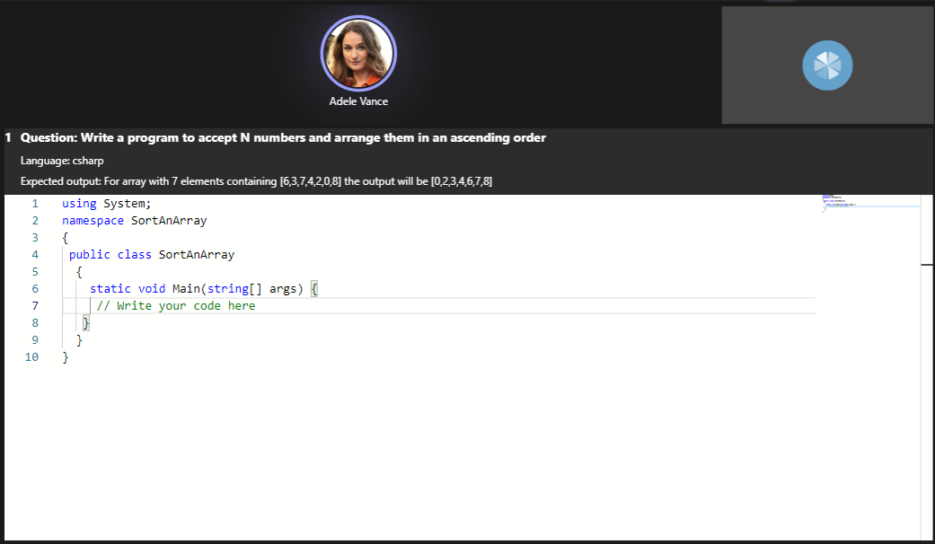
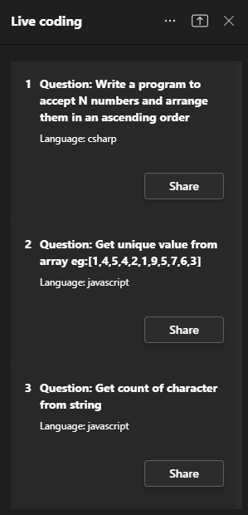
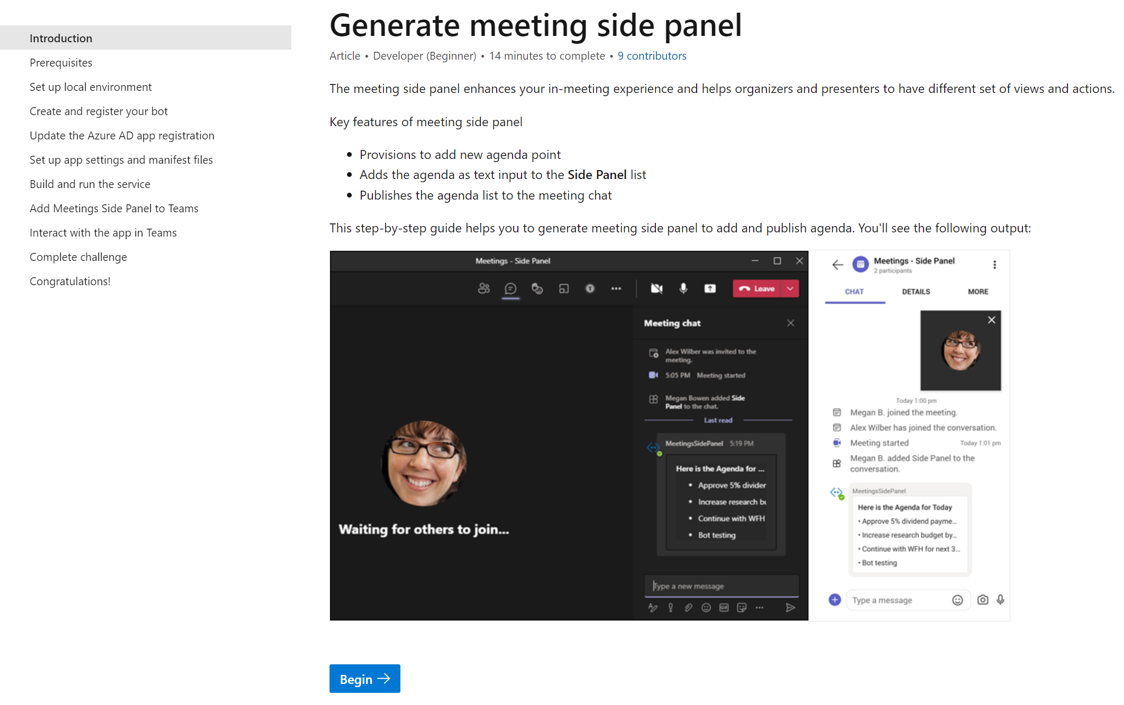






Teams Platform updates Sample code
Doc updates Step-by-step guide
1
Live coding interview sample using Meeting Stage view
2
Repo: http://aka.ms/TeamsSamples > samples > meetings-live-code-interview
Docs: http://aka.ms/TeamsDevDocs > Microsoft teams Developer documentation> Create a meeting sidepanel
@Microsoft365Dev
aka.ms/TeamsPlatformUpdates
aka.ms/TeamsDevDocs
aka.ms/TeamsSamples
aka.ms/TeamsPlatformFeedback
Notes:
Hello everyone. I’d walk you through the platform and documentation updates. Let’s start with the platform update on the left side.
Live coding interview sample using Meeting Stage view
We have a new sample which demonstrates use of Share Specific View to Stage feature in meeting.
In side panel attendees could see list of predefined coding questions for the interview.
Interviewer can choose specific question and share it in stage view.
Candidate can start writing the code to solve given problem statement which is synced with all the participants in the meeting.
This solution is published under aka.ms/TeamsSamples under meetings live code interview folder. Please clone the repo and give it a try.
Now let’s move to the doc updates on the right
2. We’ve been working on multiple step-by-step guides. Step-by-step guide is an artifact that has a task-oriented approach, linear topic, provides an end-to-end scenario, and loops you back to the documentation. So we’d be talking about the generate meeting side guide today. The meeting side panel enhances your in-meeting experience and helps organizers and presenters to have different set of views and actions. This step-by-step guide helps you to generate meeting side panel to add and publish agenda.
You can find the documentation link here. So, these were the platform updates, if you have any feedback or suggestion, please post on aka.ms/TeamsPlatformFeedback- the link is available in the footer. You could also follow us on twitter and configure to the RSS feeds to get regular platform updates.

Slide 12

https://aka.ms/techdays/m365
Notes:
hosts Microsoft Cloud Developer Advocate Waldek Mastykarz and Principal Product Manager Vesa Juvonen
Rick van Rousselt and Thomy Gölles.
Stephan Bisser.
Paolo Pialorsi.
Albert-Jan Schot.

Slide 13

EVENT
Microsoft Build
May 24-26
Registration coming soon:
https://mybuild.microsoft.com

Slide 14



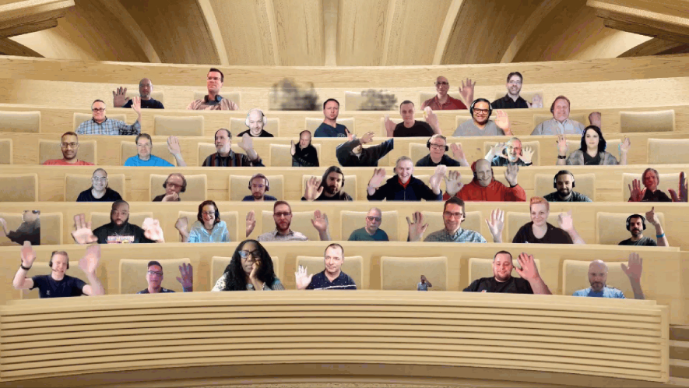


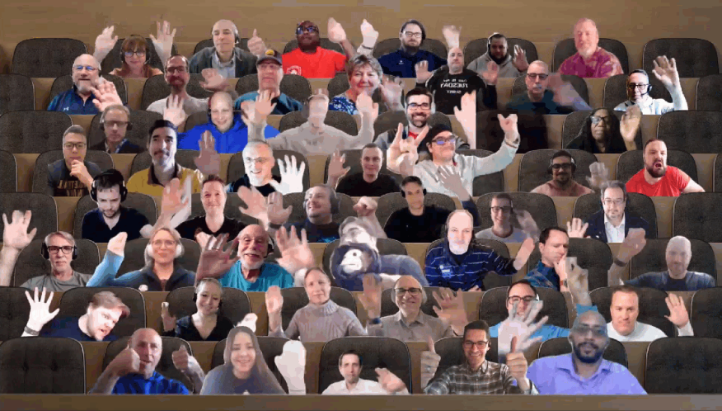




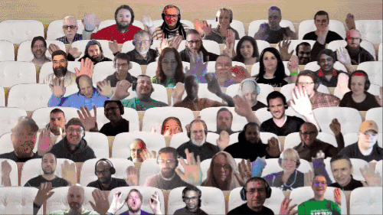



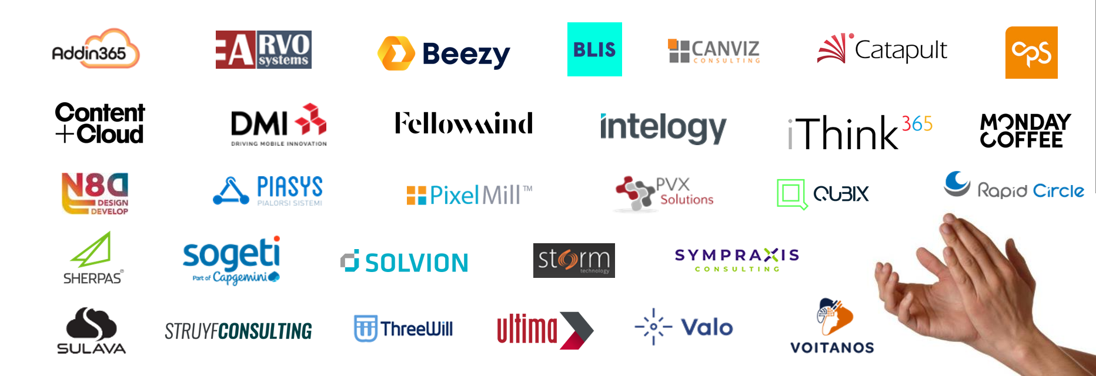




UPDATE
Microsoft 365 Platform Community (PnP) – April 2022 update is available! Thank you for your contributions!
http://aka.ms/m365pnp/community/blog
Notes:
288 community contributors on our open-source and community efforts within the past month
Collective mind and skillset of the community – building better solution which help everyone in the community as sharing is caring

Slide 15

Thank you for your assistance within last month! (A-D)
Aaron Blair
Abderahman Moujahid (iThink365) | Abderahman88
Adam Wójcik (Hitachi Energy) | @Adam2585878
Ademosu Ayodele | aaademosu
Aimery Thomas | @aimery_thomas
Akash Karda | @akkikarda
Albert-Jan Schot (BLIS Digital) | @Appieschot
Alex Gonsales (Intergen) | MrDrSushi
Alexander Ernon (Amplexor)
Alexis CONIA (Kickle) | @Alexis_conia
Alienson | @Alienson
Alistair Pugin (Tangent Solutions) | @alistairpugin
Amir Msai | amirmsai
Amjed Ayoub (Microsoft) | Amjed-Ayoub
André Lage (Datalynx AG) | @aaclage
Andrea Mondello (Withum Smith + Brown) | @Mondello_power
Andrew Burns (AmSty) | @SharePointRox
Andrew Connell (Voitanos) | @Andrewconnell
Andrew Pilcher (CSULB) | andrewpilcher
Andy Harmon (Oldham Metropolitan Borough Council) | @Andygharmon
Anjaneyulu Yarlagadda | yarlagaddaanji
Annie Torres (Coppin State University)
Anoop Tatti (Content+Cloud) | @Anooptells
Antti Pajunen (Forward Forever) | @Anttipajunen
Aric Bost (North Carolina Housing Finance Agency) | @1CyberState
Arjan Cornelissen | @arjancorneli
Arjun Menon (Tata Consultancy Services ) | @Arjunumenon
Arleta Wanat | PowershellScripts
Art Pagano (University of Texas San Antonio)
Artur Posluszny | aposl1
Arun Kumar Perumal |< @arun_perumal16
Asad Refai (Intelogy) | @AsadRefai
Ashwani Kumar (Walmart Global Tech) | @ashwanidv100
Bartolomeo Sorrentino (soulsoftware) | @BsorrentinoJ
Beau Cameron (Aerie Consulting) | @Beau__Cameron
Bob Morris (ThreeWill)
BollietMZK
Carianne Wong (Majesco) | @CW_marie
Carike Blignaut-Staden | @CarikeBStaden
Catherine Thenault (AIPSO) | @O365techcat
Chanaka Palliyaguru (Fortude) | @Chanakavp
Chandani Prajapati (Rapid Circle) | @Chandani_SPD
Chandra Sekhar Malla (Royal Group LLC) | @ChandraSMall
Chris Kent (DMI) | @TheChrisKent
Chris Sparrow (PA Consulting)
Christian Zuellig (MondayCoffee) | czullu
Christophe Humbert | @Path2SharePoint
Christopher Graves (Arvato) | @Christo48927551
Chuck Piotrowski (PIOT) | @chuckpiot
Clavin Fernandes (Rapid Circle) | @Clavinfernandes
Clement Olivier | @Clement0livier
Cynthia Tiwana (city of sammamish) | ctiwana
Damien Bird | @DamoBird365
Daniel Laskewitz (Sogeti) | @Laskewitz
Daniel Westerdale (Westerdale Solutions Ltd) | @Westerdaled
Danish Shafi | @Builtbydan
Darren Brown (Node4)
Dave Young | @Klarkykhat
David Gray (Visa)
David Pileggi (Staples) | @DavidPileggi
David Pileggi (Staples) | DavidPileggi
David Ramalho | @DRamalho92
David Warner II (Catapult) | @DavidWarnerII
Dean Gross (Insight) | @dean144
Dennis Goedegebuure (Ultima Business Solutions) | Expiscornovus
Derek Cash Peterson (Sympraxis Consulting) | @Spdcp
Dhruvil Prajapati | @dhruvilp_29
Dipen Shah (Rapid Circle) | @Dips_365
Don Kirkham (DMI, Inc) | @DonKirkham
Dr Adrian Colquhoun (Strategik) | iddycol
Notes:
SHARING KNOWLEDGE IS MULTIPLYING KNOWLEDGE

Slide 16
Thank you for your assistance within last month! (E-K)
Edmund David (Insentra)
Edris Kakembo (WFP) | @Kaxeddie
Eduardo Cáceres | eduherminio
Ejaz Hussain (Content and Cloud) | @EjazHussain"
Elio Struyf (Struyf Consulting) | @Eliostruyf
Elise Yang (Shopify) | elisenyang
Elka Dunnette | @ElkaD_YYC
Emily Mancini (Sympraxis Consulting) | @EEMancini
Erfan Darroudi | edarroudi
Eric Mases (Genmab A/S) | @Mases
Eric Overfield (PixelMill) | @EricOverfield
Erwin van Hunen (Valo Intranet) | @Erwinvanhunen
FelgeIO | FelgeIO
Florian Zink | fzbm
Franck Cornu | @FranckCornu
Ganesh R (RapidCircle) | @Geekwhocodes
Ganesh Sanap (Globant) | @GaneshSanap20
Garrick George (City of Thornton) | @Kod3m0ng3r
Gaurav Mahajan | @Mahajang
Gautam Sheth (Valo Solutions) | @Gautamdsheth
Geetha Sivasailam (Artis Consulting) | @GSiVed
Giacomo Pozzoni (Fellowmind) | jackpoz
Giuliano De Luca | @delucagiulian
Gustavo Velez | gavdPublic
Hans De Donder (Inetum-Realdolmen)
Haritha Sama (Intouch Solutions)
Harry Jones (Civica) | @Hejones50
Harsh S (SRK Consulting)
Harsh Samdani | hsamdani12
Harshini Varma (Capgemini) | @HarshiniVarmaa
HEMANT RISBUD (SRK Consultants) | Hemant Risbud
Henrik Yllemo (Ylltec Sweden AB) | @yllemo
Ian Durey (Canopy Growth Corporation)
Inez Jacobs (Amplexor)
Isolde Kanikani (SoftwareONE)
Jacob Warrington (Catapult Systems) | @Jjhwarrington
James May | fowl2
Jan Bakker | @JanBacker_
Jasey Waegebaert (MI group) | Jwaegebaert
Javier Hualpa | jhualpa
Jeffin Jacob | jeffinjacob
Jennifer Davison (Akron Children's Hospital)
Jennifer Erzen (SUNY Upstate Medical University) | @jennifererzen
Jennifer McGee (Wood PLC) | @JMcGee7
Jerker Vallbo | jerval53
Jhan Zaib (Ascertia) | jhan-zaib
Jim Duncan (ShareSquared, Inc.) | @sparcitect
Jinlong Wang | apzl808
Jiten Parmar (Rapid Circle) | @Jitenpa44241205
João Ferreira (Beezy)| @Joaoferreira
João J. Mendes (Valo Solutions) | @Joaojmendes
Joel Rodrigues (Storm Technology) | @JoelFMRodrigues
John-Paul Daly (Ashton Court Group) | TonyGlow
Jonas Björkander (Heimstaden) | @jonasbjor
Jonathan Hinchliffe (Imperial War Museums)
Jonathan Weaver (WaterOne) | @J_weaver74
Jono Duncan (JourneyTEAM) | @SuaveJono
Josh Hatherell (Canopy Growth Corp)
Julie Turner (Sympraxis Consulting) | @Jfj1997
Karan katoch (Ey) | Ktchkrn
Karine Brousse | kbrousse
Kasper Bo Larsen (Fellowmind) | @Kasperbolarsen
Kathleen Boilek (Alaka Ina Foundation) | @kaboilek
Katleen Van Trier (Inetum-Realdolmen) | @Kvantrier
Katrin Rannaste
Ken Lin (WTW) | @mvpkenlin
Kevin (Suffolk) | ketorin23
Kevin McDonnell (CPS) | @Kevmcdonk
Kim Kiefer (GenTech Associates) | @Kkkiefe
Kirt Spaulding (N/A)
Kunj Balkrishna Sangani | @Sanganikunj
Kyle Bigelow | hazondata
Notes:
SHARING KNOWLEDGE IS MULTIPLYING KNOWLEDGE

Slide 17
Thank you for your assistance within last month! (L-P)
Lance Yoder (Cerner) | @lyoder
Laura Kokkarinen (Sulava) | @LauraKokkarinen
Laurent Egbakou | @Lioncoding
Lee Ford ( Symity) | @Lee_Ford
Leon Armston (Intelogy) | @LeonArmston
Lindsay Shelton (Stowers Institute for Medical Research) | @Lshelton_tech
Loïc Cimon (Sogeti) | @LoicCimon
Luis Manez (ClearPeople) | @luismanez
Luise Freese (M365Princess) | @LuiseFreese
Manickam Sethuramalingam (microland)
Manjunath Puttaswamy (Momentive Performance Materials India Private Limited) | @ManjunathPutta3
Marc Anderson (Sympraxis Consulting) | @Sympmarc
Marcin Wojciechowski | @mgwojciech
Marie Nguyen Phu Qui (Avanade) | marie-phu-qui
Mark Allan | @MarkXA
Markus Joschko | jocsch
Markus Möller (Avanade) | @Moeller2_0
Martin Lingstuyl | @Martinlingstuy
Matt Beard (Data8) | @Mattybeard
Matt Collins-Jones | @D365Geek
Mathijs Verbeeck | MathijsVerbeeck
Mayuresh Joshi (Mindtree) | @Mayure5h
Michael Blumenthal (M365chicago.com) | @MichaelBL
Michael Rauscher | MMRauscher06
Michael Roth ( ITP) | @MichaelRoth42
Michal Guzowski (Developico) | @Abcguzowski
Michal Romiszewski | @Romiszewski
Michal Ziemba (Flugger) | @Michal_Ziemba
Michel Mendes | @Michelcarlo
Michelle Heisler (Hennepin County)
Miguel Angel García | @Miangama
Miguel Verweij | @MiguelVerweij
Mike Duffy (Boardwalk Pipelines) | @Mike_duffy
Mike Dumka (Habanero Consulting) | @Mikedumka
Mike Homol | @homol
Mike Markett (DFC)
Mike Zimm | mikezimm
Milan Holemans | milanholemans
Mohammad Amer (Atea Global Services) | @Mohammad3mer
Mohamed Ashiq Faleel | @AshiqFaleel
Monica Ryan | qwerty9988GH
Nanddeep Nachan | @nanddeepNachan
Nathan Zipf | NathZ1
Naveen Karla | @naveen67
Nicholas Honen | @nickhonen4
Nick Brown (Jisc) | @techienickb
Nicole Fleming (Sherwin Williams)
Niels | dknn
Nikki Chapple (Cloudway) | @Chapplenikki
Nizar Grindi (Avanade) | @nizar_grindi
Norm Young (UnlimitedViz) | @stormin_30
Omar Elanis | omarelanis
Omar Stewart | @OmarStewey
Paolo Pialorsi (PiaSys.com) | @PaoloPia
Patrick de Lanoy(EmpowerTech) | @EmpowerPatrick
Patrick Doran (NCDIT) | @Swearpointjs
Patrick Galloway | BammaSlim
Patrick Lamber (ExpertsInside AG) | @Patricklamber
Patrik Hellgren (Sherpas Group) | @Patrikhellgren
Paul Bullock (CPS) | @Pkbullock
Paul Culmsee (Seven Sigma) | @Paulculmsee
Paul McManus | @PaulMcManus23
Paul Schaeflein (AddIn365) | @Paulschaeflein
Pedro Monte (BindTuning) | PedroMordeP
Pete Simpkins (Fluid Interiors) | @simpkinspete
Pete Skelly (ThreeWill ) | @Pskelly
Phil McNiven | phil0074
Pierre Geraud (Bluekango) | pedrion
Prafull Kotecha | @Prafull
Pranav Khurana
Prasad Kasireddy (Kyndryl) | @Prasad_kasiredd
Notes:
SHARING KNOWLEDGE IS MULTIPLYING KNOWLEDGE

Slide 18
Thank you for your assistance within last month! (R-Z)
Rafay Ali (self no company) | @365SPTechTips
Ralph Rivas (Sogeti) | @Bigpix2000
Ravichandran Krishnasamy | @spfx_blog
Rentu | SLdragon
Reshmee (Ppf) | @Reshmeeauckloo
Reshmee Auckloo (Pension Protection Fund) | @ReshmeeAuckloo
Rick Van Rousselt (Advantive) | @RickVanRousselt
r-markus | r-markus
Rob Bell (Kizan technologies)
Rob Ireland (Oast House Ltd) | @RobIreland68
Robert Copelan (ZF Friedrichshafen AG) | @Rcopelan
Robert Dyjas (EQTek) | @Robdy
Robin Rosengrün (EnBW) | @power_r2
Rocky (Wa State DES)
Rodrigo Pinto (Storm Technology) | @ScoutmanPt
Rohit S Patil (C3it)
Rolands Strakis | wonderplayer
Russell Gove (tronox) | @Russgove
Ruth Shyer (SuMMit Consulting, LLC) | @Rshyer
Ryan Healy (365Apps) | @Ryan365Apps
Sabrina Faragoza (Cognizant's Microsoft Business Group)
Sachchin Annam (Freelancer) | @Sachchinn
Sam Bridegroom (Allied Solutions) | @sambridegroom
Sandeep Unnikrishnan | SandeepDev365
Sekar Thangavel (IBM) | SekarThangavel
Sergei Sergeev | @Sergeev_srg
Sharon Weaver (Smarter Consulting) | @Sharoneweaver
Shishir | skky05
Shrushti Shah (Rapid Circle)
Siddharth Vaghasia | @Siddh_me
Simon Ågren | @AgrenPoint
Simon Doy (iThink 365) | @Simondoy
Simon Hudson (Novia Works) | @simonjhudson
Smita Nachan | @SmitaNachan
Someleze Diko | DikoSomeleze
Sorina Becheru (abtis GmbH)
Soumit Mukherjee | @Msoumit
Soumyadeep Mukherjee | soumyadeep2207
Sourav Paul | @Spsouravp
Stacie Moody | @ShadowTechFx
Stefan Bauer (n8d) | @StfBauer
Stephan Bisser (Solvion) | @Stephanbisser
Stephan Steiger | robi26
Stéphane Chandonnet (Université Laval) | @Stchandonnet
Steven Reid (FTZ) | @Steven_reid
Sudharsan Kesavanarayanan | @sudharsank
Sujith Pasupuleti (NRF) | @Sujith1907
Sumit Jadon (Avanade) | @CoolJadon
Sunish (SACHA Solutions) | @Sunish
Takashi Shinohara | @Karamem0
Tammy Dupuy (CSULB)
Taylor Sand | taylorsand
Tetsuya Kawahara | @Techan_k
Thomas Gölles (Solvion) | @Thomyg
Tim Balk (Wellmark) | @Tlbalk
Tim Cadenbach (Maximago) | @TimCadenbach
Tod Beane
Todd Alexander (Island Way Technology)
Todd Baginski (Canviz) | @Toddbaginski
Tom Morgan (Modality Systems) | @tomorgan
Tomasz Poszytek | @TomaszPoszytek
Tony Derricott (BYUI) | @computx
Troy Taylor (Hitachi Solutions) | @Troystaylor
Twan van Beers (Nero Blanco) | @neroBlancoIT
Vardhaman Deshpande (Valo Solutions) | @vrdmn
Veronique Lengelle (CPS) | @Veronicageek
Victor Ezeliorah (Intels Nigeria Limited) | @vezeliora
Vipul Kelkar (Rapid Circle) | @Vipulkelkar
Vivek Bavishi | @That_API_guy
Woong Choi (Seven Sigma)
wuxiaojun514 | wuxiaojun514
Yannick Plenevaux (PVX Solutions) | @Yp_code
Youssef Moumen
Yves Habersaat (Sword Group) | @Yhabersaat
Zach Roberts | @ZachSPODev
Notes:
SHARING KNOWLEDGE IS MULTIPLYING KNOWLEDGE

Slide 19































Companies involved with April 2022 summary
Companies which provided support for community
We can only show the company logos which we have explicitly approval for logo usage
You contributed and your company is not here? – Send us a message with your permissions and logo
Notes:
SHARING KNOWLEDGE IS MULTIPLYING KNOWLEDGE

Slide 20

Thank you for your assistance! – Microsoft
Aakash Bhardwaj (Microsoft) | @Aakash_316
Abid Rahman (Microsoft)
Alex Clark (Microsoft) | @Sharepointalex
Alex Terentiev (Microsoft) | @Alexaterentiev
Alexis Kinzelin (Microsoft)
Aline Tognini (Microsoft) | alinefmr
Allen Snow (Microsoft) | @Asnow003
Altamish Ahmad (Microsoft)
Andrey Esipov (Microsoft)
April Dunnam (Microsoft) | @Aprildunnam
Arijit Mondal (Microsoft)
Arvind Ravi (Microsoft)
Ashima Mathur (Microsoft)
Ayca Bas (Microsoft) | @Aycabs
Bert Jansen (Microsoft) | @O365Bert
Beverly Kim (Microsoft) | bvandaal
Bob German (Microsoft) | @Bob1German
Brian Dang (Microsoft) | @Mrdang
Brian Jackett (Microsoft) | BrianTJackett
Bryan Petersen (Microsoft) | bpeterse03
Cathy Dew (Microsoft) | @Catpaint
Charles Sterling (Microsoft) | @Chass
Chris Gross (Microsoft)
Christer Ljung (Microsoft)
Christos Matskas (Microsoft) | @ChristosMatska
Dan Wahlin (Microsoft) | @DanWahlin
Dave Randall (Microsoft) | triplanedave
David Chesnut (Microsoft) | @Davidchesnut
Dhurata Jahiu | DhurataJ
Doğan Erişen (Microsoft) | derisen
Dragan Panjkov (Microsoft) | @Panjkov
Ed Averett (Microsoft) | Ed_Everett
Emily Lynam (Microsoft)
Elizabeth Samuel (Microsoft)
Emma Cooper (Microsoft)
Garry Trinder (Microsoft) | @Garrytrinder
Haimantika Mitra (Microsoft) | @HaimantikaM
Harald Liavaag (Microsoft)
Harshit Kumar (Microsoft)
Holger Lutz (Microsoft) | HolgerLutz
Hugo Bernier (Microsoft) | @Bernierh
Igor Ribeiro (Microsoft)
James Eccles (Microsoft) jameseccles
James Skay (Microsoft) | @JamesSka
Japhlet Nwamu (Microsoft) | @Japhletnwamu
Jasey Waegebaert (Microsoft) | Jwaegebaert
Jasmine Hoegh (Microsoft) | @Sbjishu
Jason Johnston (Microsoft) | jasonjoh
Jay Hangan (Microsoft)
John Nguyen (Microsoft) | johnguy0
John Sudds (Microsoft) | @Jsuddsjr
Jos Verlinde (Microsoft) Josverl
Jyoti Pal (Microsoft)
Kavishi Agarwal (Microsoft)
Kevin Coughlin (Microsoft) | @Kevintcoughlin
Keyur Patelsdata (Microsoft)
Koen Zomers (Microsoft) | @Koenzomers
Holland Kaviani (Microsoft)
Laura Graham (Microsoft) | Lauragra
Holland Kaviani (Microsoft)
Lee Stott (Microsoft) | @Lee_Stott
[Linda Delarvé (Microsoft)
Linda Lu Cannon - (Microsoft) | lindalu-MSFT
Loki Meyburg (Microsoft) (Microsoft) | @Lokimeyburg
Luca Bandinelli (Microsoft) | lucaband
Mansa MusaLe (Microsoft) | @M4musale
Mathangi Chakrapani (Microsoft)
Matthijs Hoekstra (Microsoft) | @Mahoekst
Max Kulakov (Microsoft)
Michael Aldridge (Microsoft)
Mikael Svenson (Microsoft) | @Mikaelsvenson
Mike Hollinshead (Microsoft) | @Mahollinshea
Musale Martin (Microsoft) | m4musale
Nancy Wang (Microsoft) | @nancyatMSFT
Natalie Pienkowska (Microsoft) | @nataliePienkow1
Nathan Zipf (Microsoft) | NathZ1
Nick Adman (Microsoft)
Nick Kramer (Microsoft)
Nik Charlebois (Microsoft) | @nikCharlebois
Nicolas Vogt (Microsoft) | vogtn
Nikolay Zainchkovskiy (Microsoft) | NZainchkovskiy
Nickii Miaro (Microsoft) | Nickii Miaro
Niko (Microsoft) | NikoMix
Nikola Metulev (Microsoft) | @Metulev
Orion O'Malley (Microsoft)
Pam Green (Microsoft) | @Contextuallib
Parag Jain (Microsoft)
Pat Miller (Microsoft) | @PatMill_MSFT
Patrick Rodgers (Microsoft) | @Mediocrebowler
Phoebe Yuan (Microsoft)
Rabia Williams (Microsoft) | @Williamsrabia
Rajdeep Chandra
Ravichandran Krishnasamy (Microsoft) | @Spfx_blog
Richard Astbury (Microsoft) | @Richorama
Rick Kirkham (Microsoft)
Rinki Bera (Microsoft)
Roel (Microsoft) | RoelVB
Roy Paar(Microsoft)
Rui Santos (Microsoft)
Sam Larson (Microsoft) | salarson
Sébastien Levert (Microsoft) | @Sebastienlevert
Shane Weaver (Microsoft) | shweaver-MSFT
Shreyansh Agrawal (Microsoft) | shagra-ms
Sirui Sun (Microsoft)
Srinivas Varukala (Microsoft) | @Svarukala
Steven Jia (Microsoft) | Steven-Jia
Shubham Gatkal (Microsoft)
Tejas Mehta (Microsoft) | @Tpmehta
Tim Mayo (Microsoft) | @Timmayo
Tom Moser (Microsoft)
Tom Resing (Microsoft) | @Resing
Tomomi Imura (Microsoft) | @Girlie_mac
Vesa Juvonen (Microsoft) | @Vesajuvonen
Vincent Biret (Microsoft) | @baywet
Wajeed Shaikh | @Wajeed_Shaikh
Waldek Mastykarz (Microsoft) | @Waldekm
Wictor Wilen (Microsoft) | @Wictor
Wong Song (Microsoft) | WonSong
Yujie Zhang | yjiez
Zakiullah Khan (Microsoft)
Notes:
SHARING KNOWLEDGE IS MULTIPLYING KNOWLEDGE

Slide 21
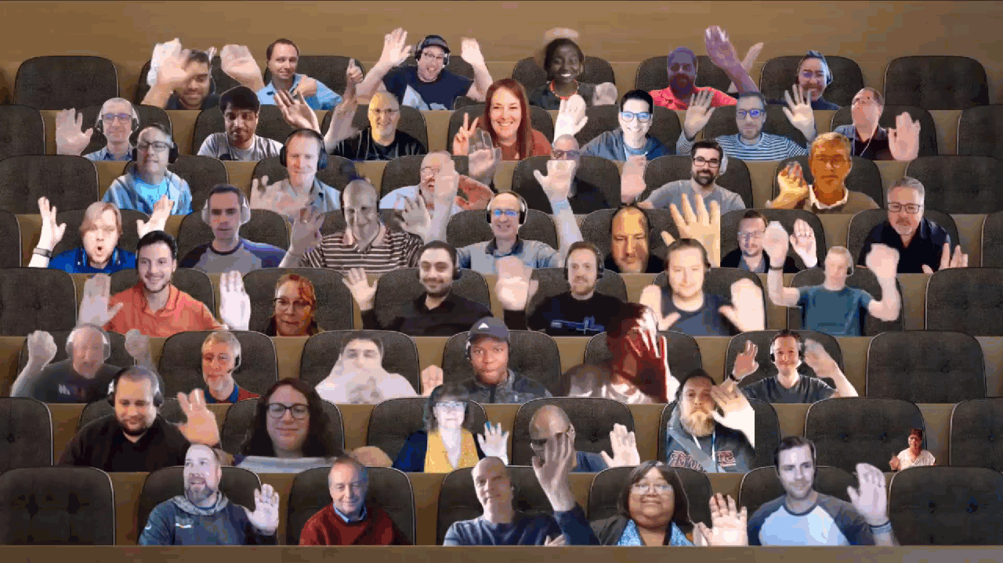

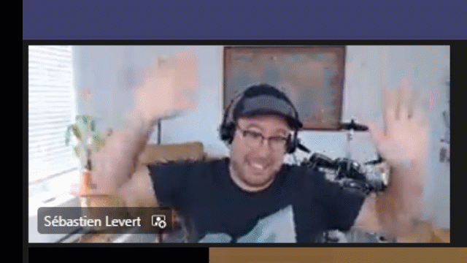
Optional picture time!
Video on and we’ll grab a Together Mode pic with those who are willing to do this.
We are together on this as a community!
Let’s all be like Seb
By enabling your camera for the picture, you grant us permission to share your picture in social media.

Slide 22

DEMO
Latest on Microsoft Graph Data Connect datasets
– Nik Charlebois
Extending Teams apps to Outlook and Office.com
– Saurabh Bhatia
Graph connectors updates and Postman samples
– Brian T. Jackett

Slide 23
Microsoft 365 developer community calls
Microsoft 365 platform call (weekly) https://aka.ms/m365-dev-call
Adaptive Cards (monthly) https://aka.ms/adaptivecardscommunitycall
Microsoft identity platform (monthly) https://aka.ms/IDDevCommunityCalendar
Office Add-ins (monthly) https://aka.ms/officeaddinscommunitycall
PowerApps (monthly) https://aka.ms/PowerAppsMonthlyCall
Microsoft 365 Community (bi-weekly) https://aka.ms/m365-dev-sig
Viva Connections and SPFx (bi-weekly) https://aka.ms/spdev-spfx-call
All calls and assets: https://aka.ms/m365pnp
Notes:
m365-dev-sig

Slide 24
Thank you
Recording will be available in 24 hours on
Microsoft 365 Community (PnP) YouTube channel
https://aka.ms/M365PnP/videos
(subscribe today)
Follow us on Twitter
@Microsoft365Dev | @M365PnP
Next Microsoft 365 Platform call: April 26th at 08:00 am PT
All available community calls from https://aka.ms/m365pnp

Slide 25



aka.ms/m365pnp

